Slide 1
Machine Learning CS F464
Dr. Pranav M. Pawar

Slide 2
Contents
Artificial Neural Network
Introduction
McCulloch Pitts Neuron
Perceptron Learning
Sigmoid Neuron
Multilayer Perceptron (as a Feed Forward Neural Network)
Network Training
Backpropagation

Slide 3
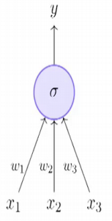
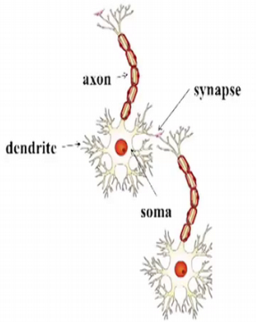
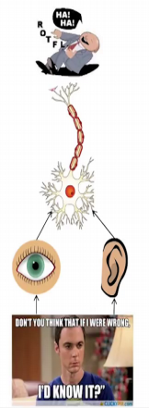
Introduction
Fundamental unit of a artificial neural network is something known as an artificial neuron.
The inspiration comes from biology and more specifically it comes from the brain.
Biological neuron => neural cells => neural processing unit
Structure of biological neuron
Dendrite, receive inputs from all the other neurons.
Synapse, point of connection to other neuron.
Soma, process the information.
Axon, transmits the output of this neuron.

Slide 4
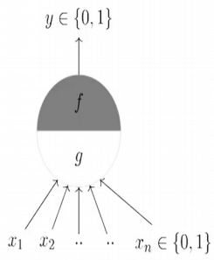
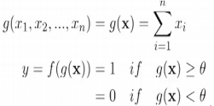
McCulloch Pitts (MP) Neuron
Highly simplified computational model of the neuron (1943)
g aggregates the inputs and the function f takes a decision based on this aggregation.
The inputs can be excitatory or inhibitory.
y = 0 if any x_{i} is inhibitory, else
Ө is called the thresholding parameter, which is also called as Thresholding logic.

Slide 5
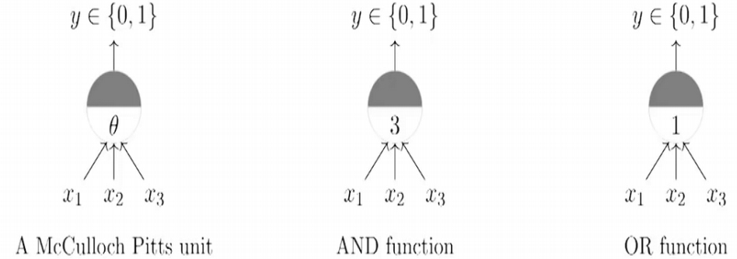
Boolean Functions using MP
Threshold for AND is 3, it will be on if all three inputs are on.
Threshold for OR is 1.

Slide 6
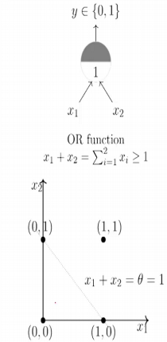
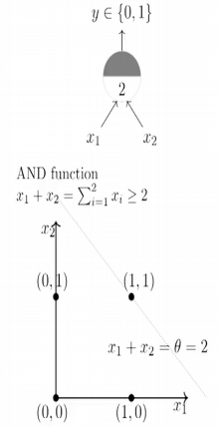
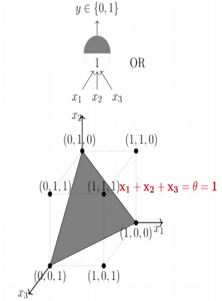
Geometric Interpretation of MP
Limitation: Single McCulloch Pitts neuron can be used to represent Boolean functions which are linearly separable
A linearly separable function is such that there exists a line such that for that function whichever points produce an output of 1 lie on one side of the line and whichever points produce an output 0 lie on the other side of the line.

Slide 7
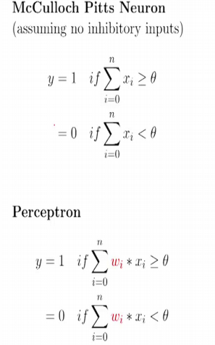
Perceptron (1)
Classical perceptron model is proposed by Frank Rosenblatt (1958).
Difference: Introduction of numerical weights for inputs and a mechanism for learning these weights.
Now input no longer limited to Boolean values.
The model is refined by Minsky and Papert (1969), referred as Perceptron model.

Slide 8
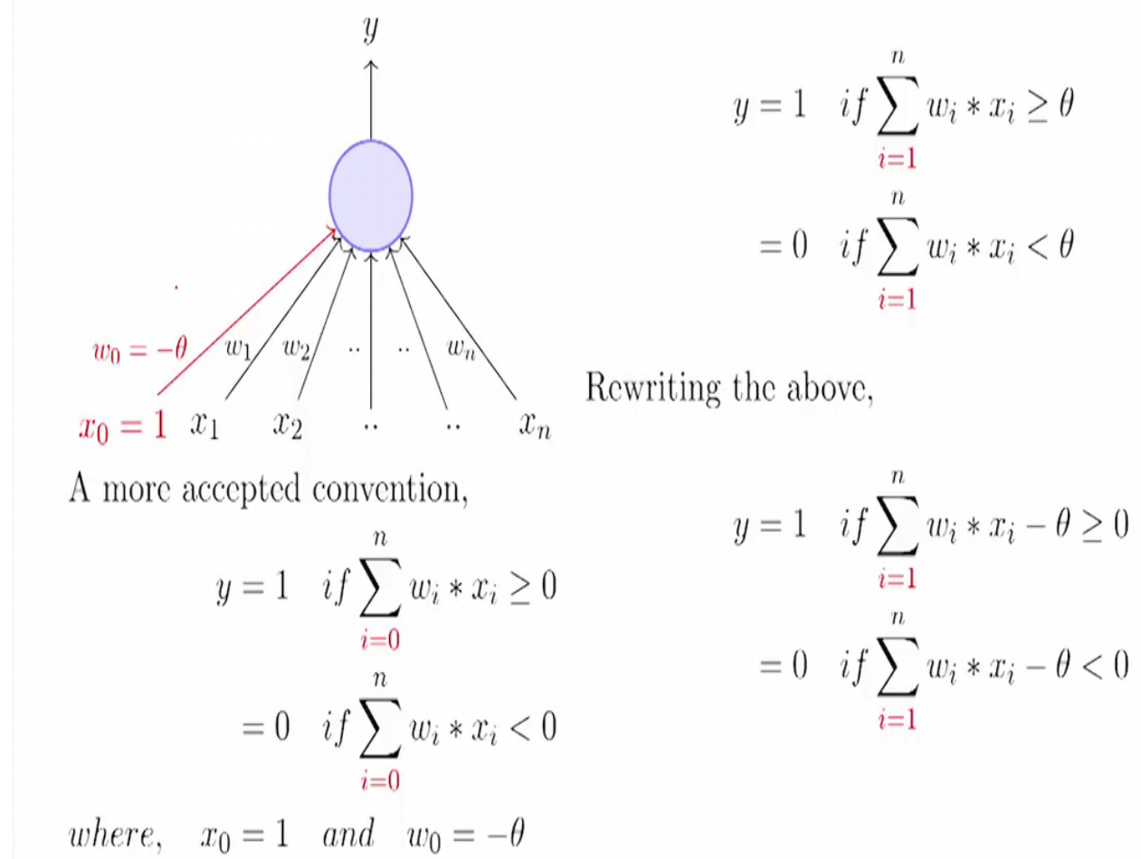
Perceptron (2)
Weights and biases are depends on data, which is need to be learn.
Bias is a prior w_{0.}

Slide 9
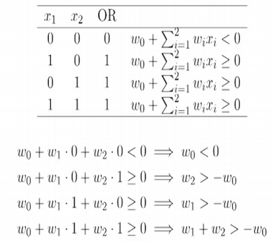
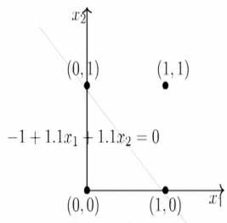
Perceptron (3)
Possible solution for above set of inequalities is w0=-1, w1=1.1, w2=1.1.

Slide 10
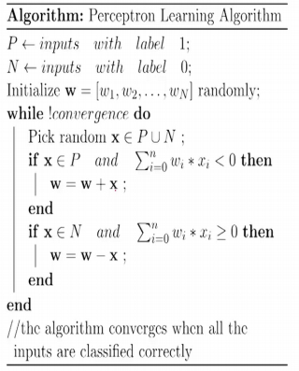
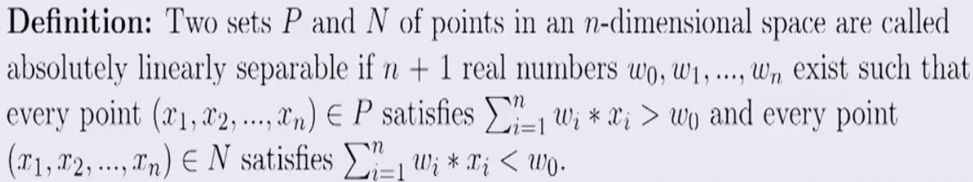
Perceptron Learning Algorithm

Slide 11
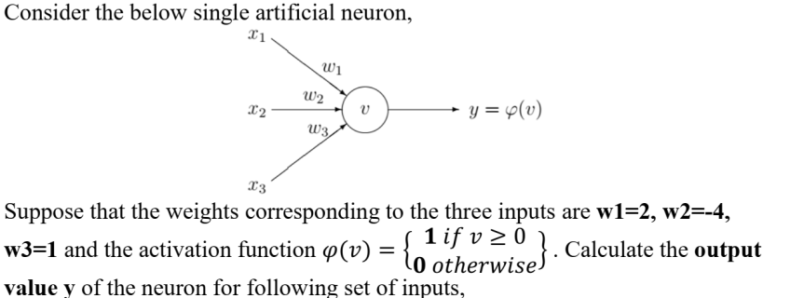
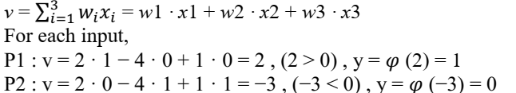

Slide 12
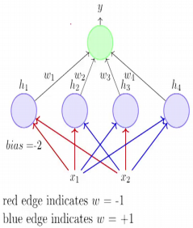
Multilayer Perceptron (1)
MLP contains layers of neurons
Network contains 3 layers (example figure)
Input layer : x₁, x₂
Hidden layer: 4 perceptron
Output layer: 1 neuron
Output of hidden layer perceptron: h₁, h₂, h₃, h₄
Layer 1 weights: w=-1,w=+1
w₁, w₂, w₃, w₄ are layer 2 weights.

Slide 13
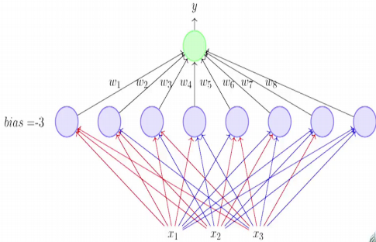
Multilayer Perceptron (2)
Simple rule: Any boolean function n inputs can be represented by a network of perceptrons containing 1 hidden layer with 2^{n} perceptrons and one output layer containing 1 perceptron.

Slide 14
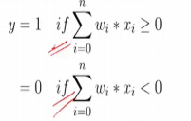
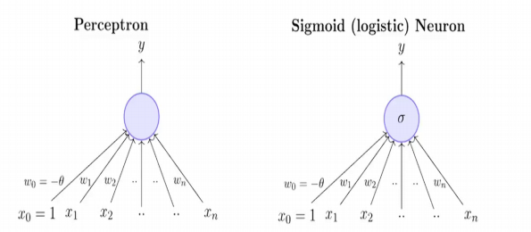
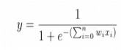
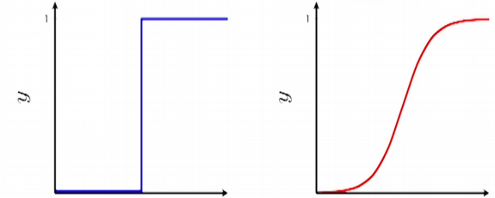
Perceptron vs Sigmoidal Neuron
Not smooth, not continuous, not differentiable
Smooth, continuous, differentiable

Slide 15
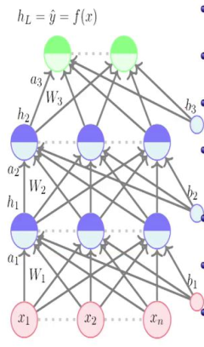
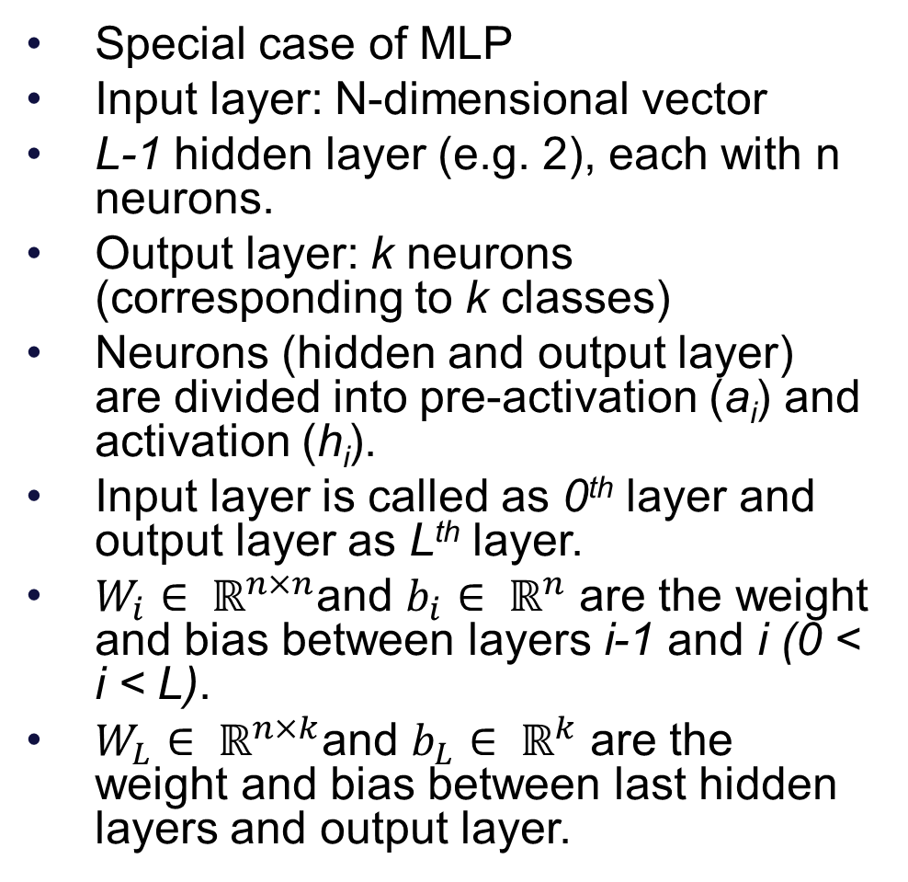
Feed Forward Neural Network (1)
Special case of MLP
Input layer: N-dimensional vector
L-1 hidden layer (e.g. 2), each with n neurons.
Output layer: k neurons (corresponding to k classes)
Neurons (hidden and output layer) are divided into pre-activation (a_{i}) and activation (h_{i}).
Input layer is called as 0th layer and output layer as Lth layer.
$W_{i}∈ ℝ^{n×n}$and $b_{i}∈ ℝ^{n}$ are the weight and bias between layers i-1 and i (0 < i < L).
$W_{L}∈ ℝ^{n×k}$and $b_{L}∈ ℝ^{k}$ are the weight and bias between last hidden layers and output layer.

Slide 16
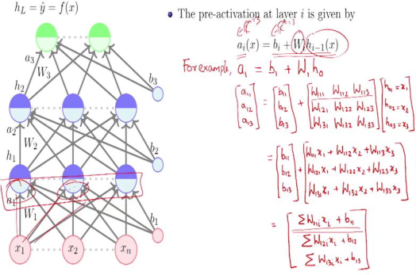
Feed Forward Neural Network (2)

Slide 17
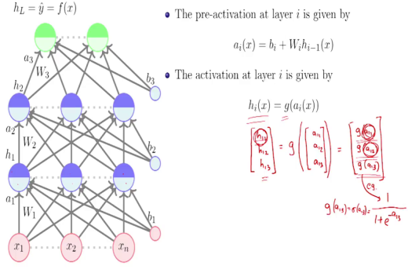
Feed Forward Neural Network (3)

Slide 18
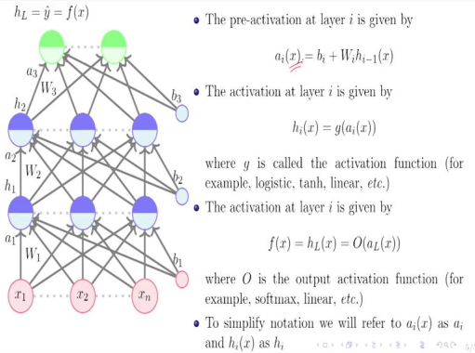
Feed Forward Neural Network (4)

Slide 19
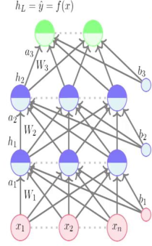
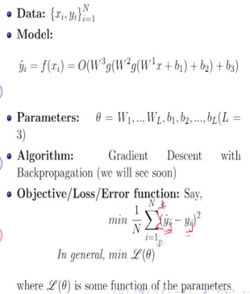
Supervised Learning in FFNN

Slide 20
Decision Boundary
0 hidden layers: linear classifier
Hyperplanes

Slide 21
Decision Boundary
1 hidden layer
Boundary of convex region (open or closed)
Notes:
We saw with XOR

Slide 22
Decision Boundary
2 hidden layers
Combinations of convex regions

Slide 23

Activation Functions

Slide 24
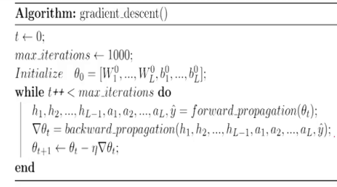
Training NN (1)

Slide 25
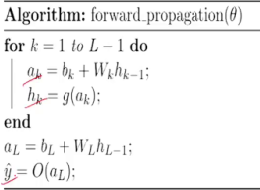
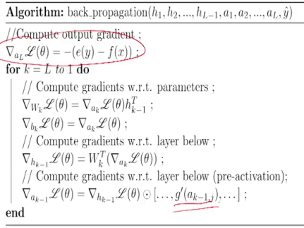
Training NN (2)

Slide 26
Backpropagation (1)
Given:
Chain Rule:
Backpropagation is just repeated application of the chain rule from Calculus.

Slide 27
Backpropagation (2)
Output
y
Case 1:
Logistic Regression
θ₁
θ₂
θ₃
θ_{M}
Input
x₁
x₂
x₃
…
x_{M}
27

Slide 28
Backpropagation (3)
Output
y
Hidden Layer
z₁
z₂
…
z_{D}
Input
x₁
x₂
x₃
…
x_{M}

Slide 29
Backpropagation (4)
Case 2:
MLP
y
z₁
z₂
…
z_{D}
x₁
x₂
x₃
…
x_{M}

Slide 30
Sources
Chapter 4, Tom M. Mitchell, Machine Learning, The McGraw-Hill Companies, 1st edition 2013.
Chapter 5, Christopher M Bishop: Pattern Recognition & Machine Leaning, 2006 Springer.
Deep Learning Course by Dr Mitesh Khapra, https://nptel.ac.in/courses/106/106/106106184/
https://www.cs.cmu.edu/~mgormley/courses/10601b-f16
“Machine learning with Python course”, IBM

Slide 31
Thank You!

